Slide 1

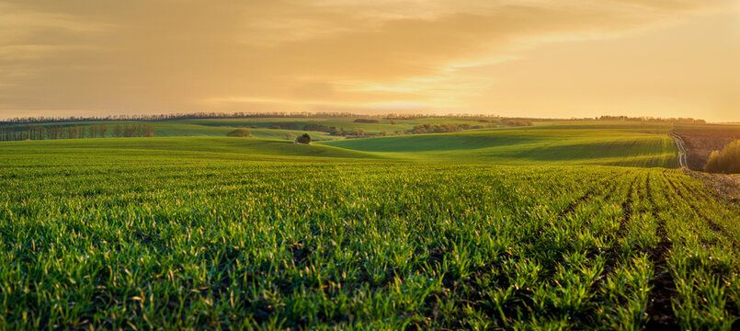
Smart Agricultural Drone Surveillance System for Precision Farming
Presented by :
Pratyusha Chatterjee
Supervised By:
Dr. Tanima Bhowmik
Institute of Engineering and Management , Kolkata, India

Slide 2
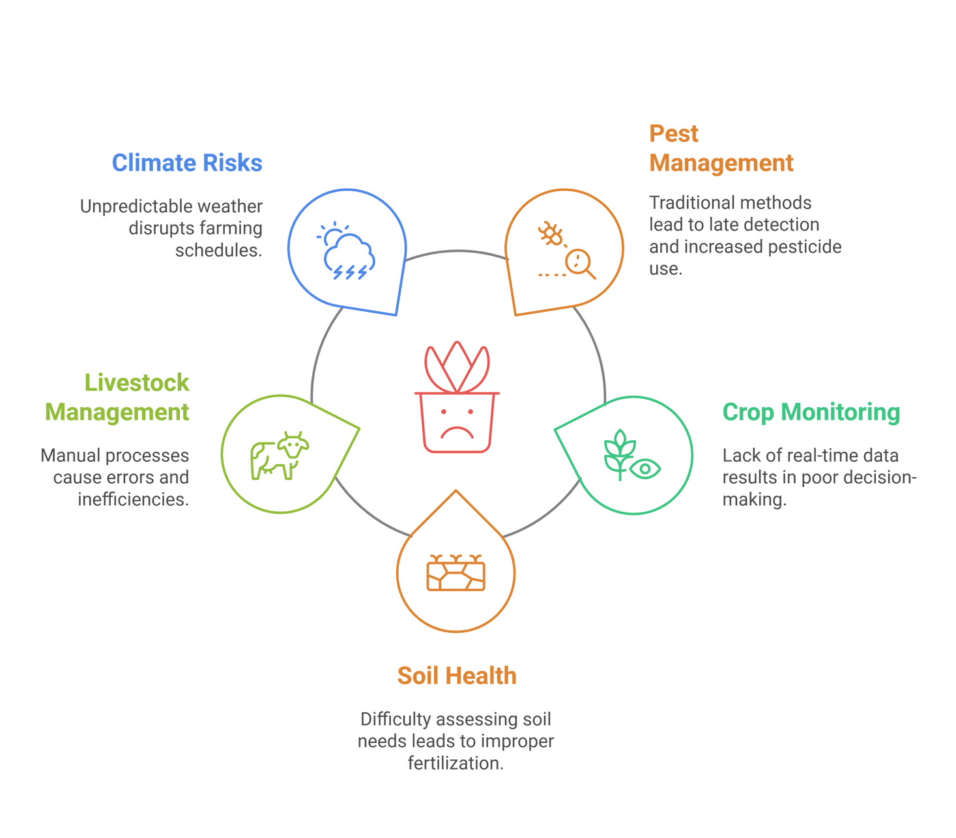
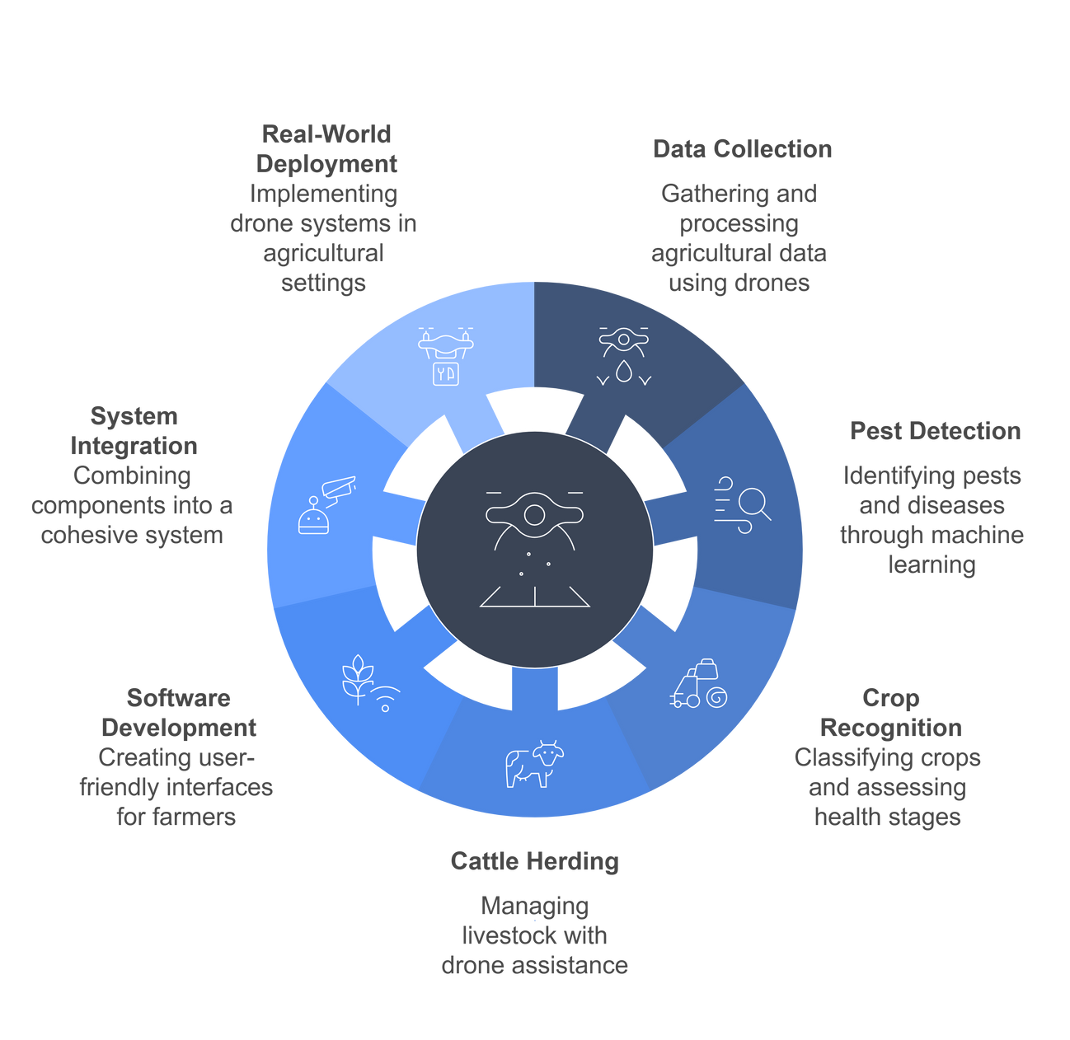
Problem Statement
Proposed Solution

Slide 3
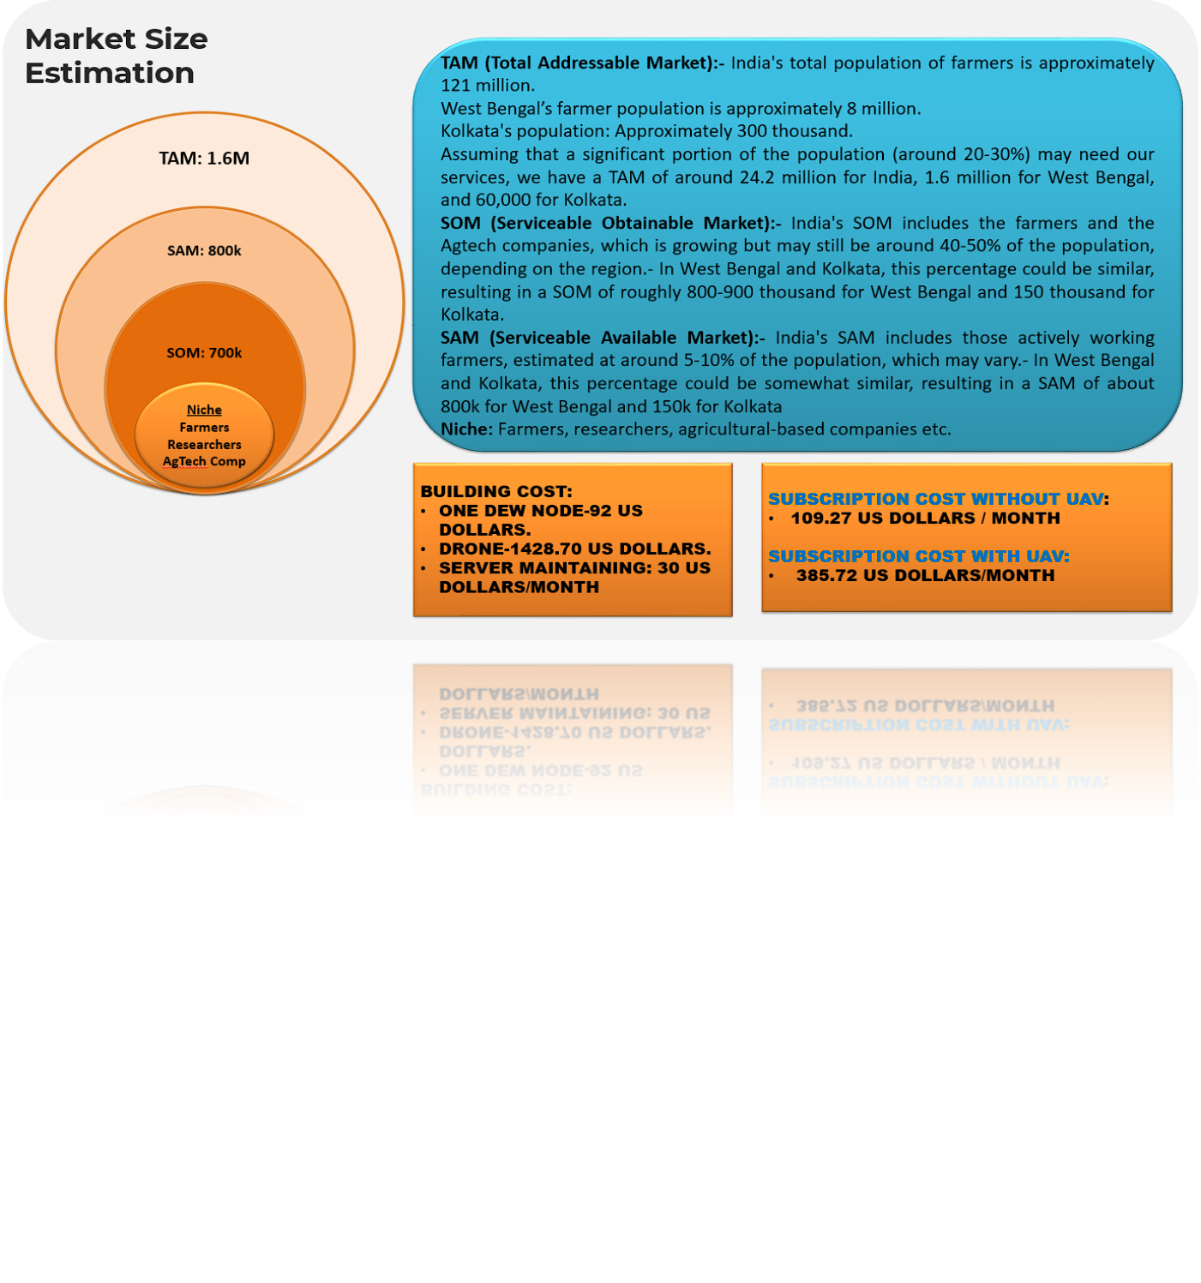
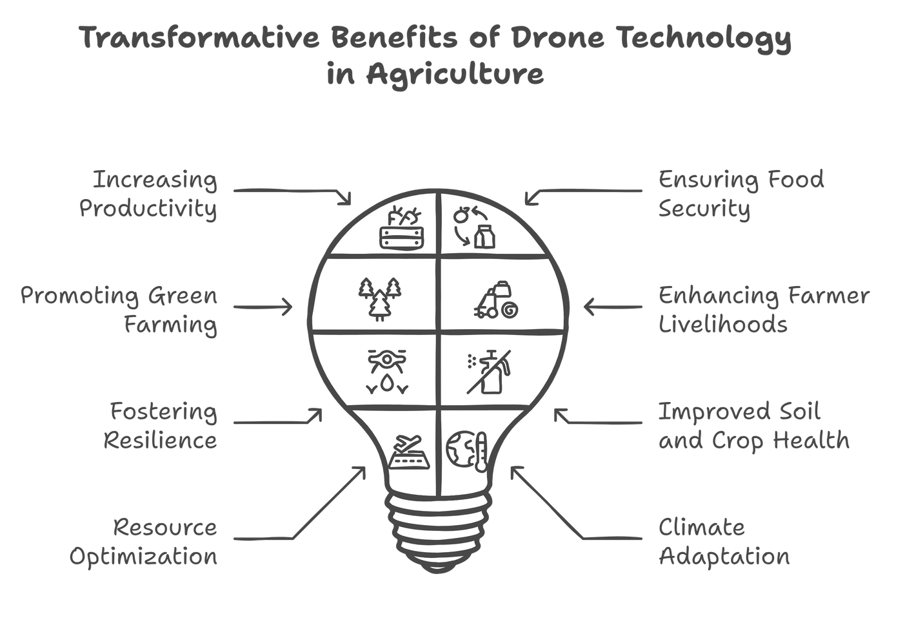
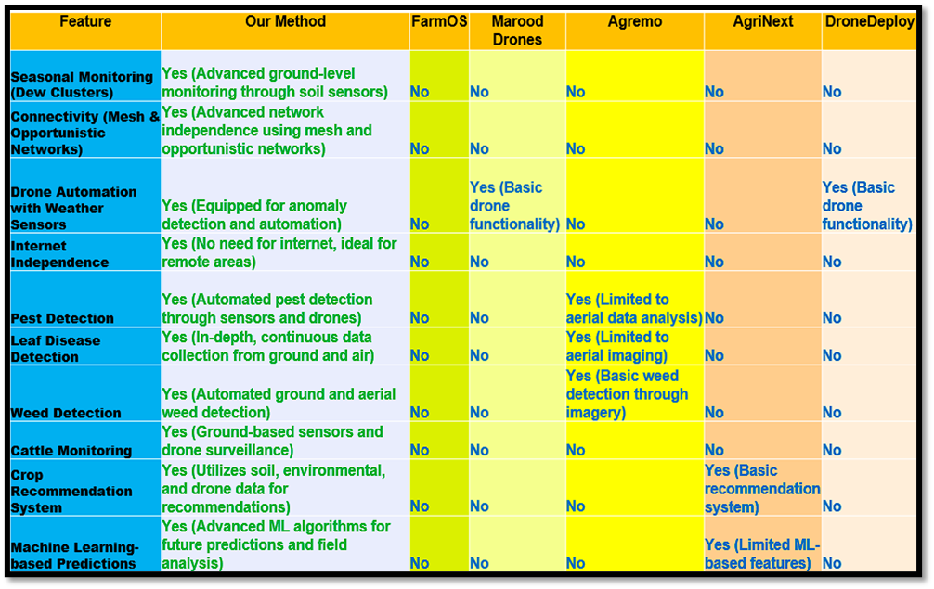
Impacts and benefits
BUILDING COST:
ONE DEW NODE - 46.48 US DOLLARS
DRONE - 464.8 US DOLLARS
SERVER MAINTAINING – 11.62 US DOLLARS/MONTH
SUBSCIPTION COST WITHOUT UAV:
34.86 US DOLLARS
SUBSCIPTION COST WITH UAV:
162.68 US DOLLARS
Are Others Meeting the Challenge?
TAM (Total Addressable Market):- India's total population of farmers is approximately 121 million.
West Bengal's farmer population is approximately 8 million.
Kolkata's population: Approximately 300 Thousand.
Assuming that a significant portion of the population (around 20-30% ) may need our services, we have a TAM of around 24.2 million for India, 1.6 million for West Bengal, and 60,000 for Kolkata.
SOM (Serviceable Obtainable Market):- India's SOM includes the farmers and the Agtech companies, which is growing but may still be around 40-50% of the population, depending on the region.- In West Bengal and Kolkata, this percentage could be similar, resulting in a SOM of roughly 800-900 thousand for West Bengal and 150 thousand for Kolkata.
SAM (Serviceable Available Market):- India's SAM includes those actively working farmers, estimated at around 5-10% of the population, which may vary.- In West Bengal and Kolkata, this percentage could be somewhat similar, resulting in a SAM of about 800k for West Bengal and 150k for Kolkata
Niche: Farmers, researchers, agricultural-based companies etc.

Slide 4
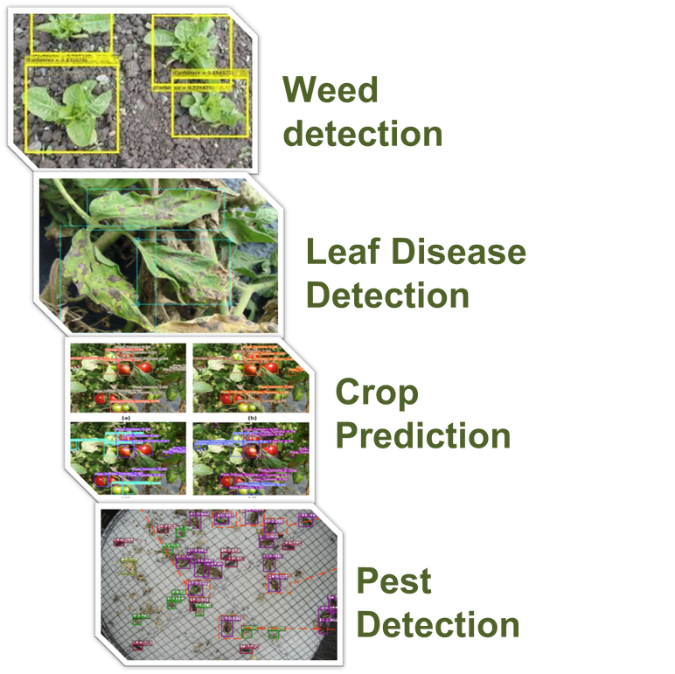
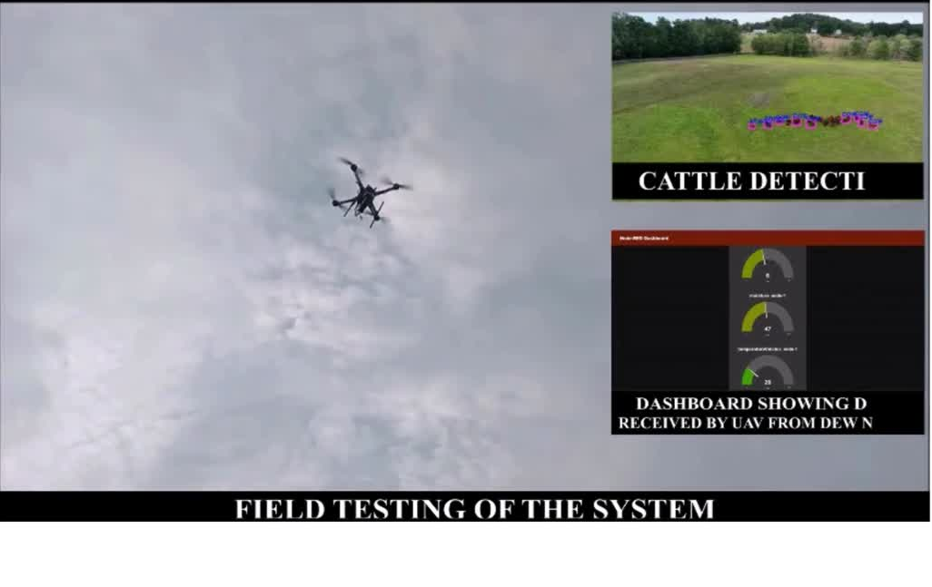
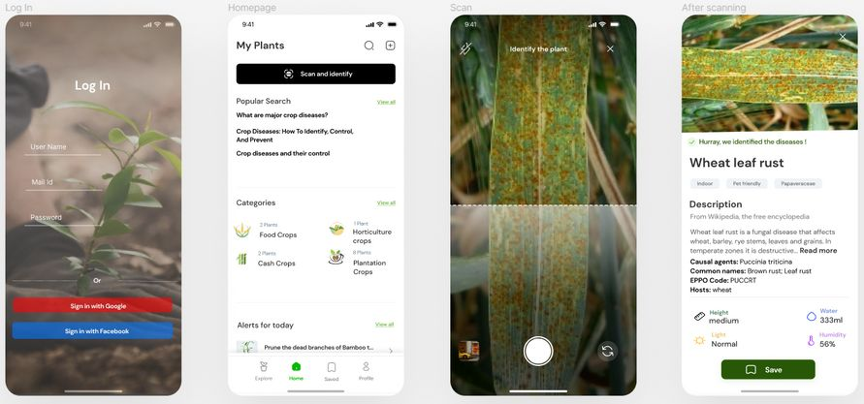
Testing and Results
Prototype Testing
Outputs & Results :
Our assistant App
Our prototype was tested under actual farm conditions, delivering exceptional results and exceeding expectations. We tackled initial challenges and fine-tuned the design, ensuring optimal performance. This solution is now primed for scalability, offering a reliable, high-impact opportunity for investors.

